Slide 1
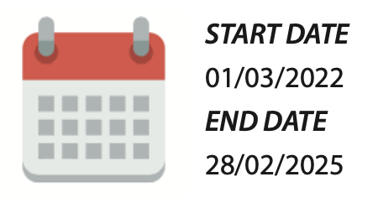
Deep U-tube heat exchanger breakthrough: combining laser and cryogenic gas for geothermal energy exploitation
PROJECT DURATION
COORDINATOR
PhD. Eloisa Di Sipio
eloisa.disipio@unipd.it

Slide 2
THE DeepU PROJECT CONCEPT
Optimising access to deep geothermal resources with new state-of-the-art drilling technologies to unleash clean, abundant energy from the Earth
Goals
Geothermal energy accessible anywhere
Extract energy from deep (>4 km) U-shaped closed-loop geothermal heat exchangers (HE)
Reduce the costs of well drilling and provide HE immediately developed after drilling

Slide 3
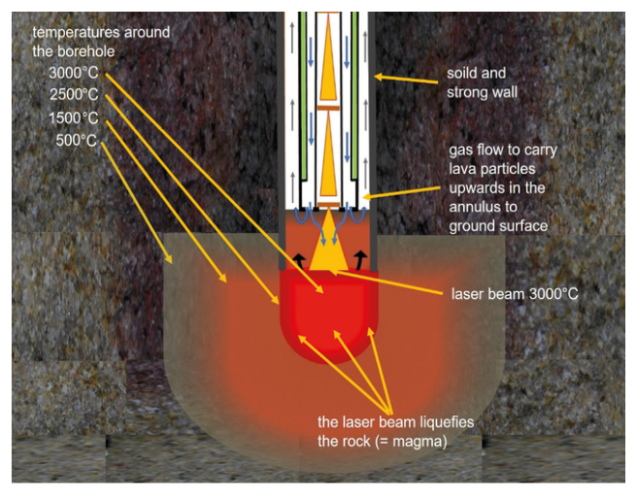
INNOVATIVE DRILLING TECHNOLOGY
A laser propulsion drilling method is combined with cryogenic gaseous flushing for cooling the laser drill head.
Improved ROP
Reduced drilling time and cost
In case a glazed layer is formed on the borehole walls, the obtained systems are physically isolated from the surrounding formations and immediately developed after drilling without requiring further casing activities.
Reduced time and cost for setting up the HE

Slide 4
THE DeepU PROJECT OBJECTIVES
Develop and calibrate the drilling technology by:
  selecting a cryogenic gas able to cool in a controlled manner the rock melted by a laser;
  developing an innovative lightweight drill string able to host the gas and the laser at the same time;
  developing specific temperature control analysis and innovative laser lenses able to convey the heat and to sustain multilateral drilling;
Determine the physical-thermal phenomena affecting different kinds of rocks to assess the borehole wall vitrification and integrity;
Evaluate the legislative aspects and environmental standards related to the innovation proposed;
Define the DeepU geothermal exploitation potential, including economic analyses, based on case studies modelling.

Slide 5
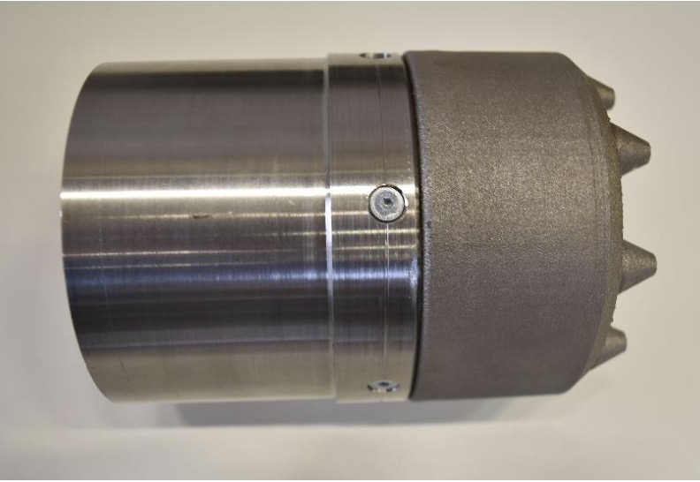
A NOVEL PROCESSING HEAD
FOR LASER DRILLING
With the help of the processing head, the cryogenic gas stream is directed onto the rock, which is melted by a high-power laser beam.
The first operational prototype consists of the titanium alloy Ti-6Al-4V in order to meet the requirements for the component in terms of mechanical strength and temperature resistance.
It has been 3D printed for rapid prototyping and to simplify printing the gas channels directly into the component.

Slide 6
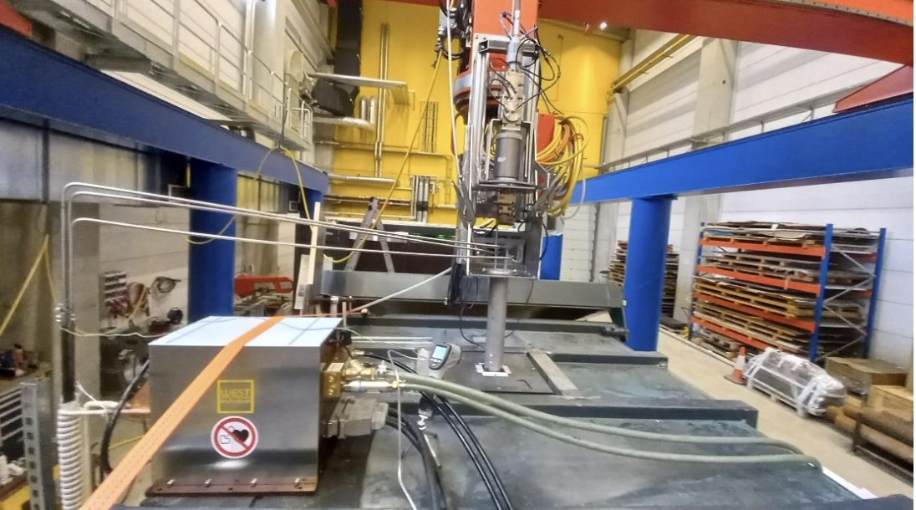
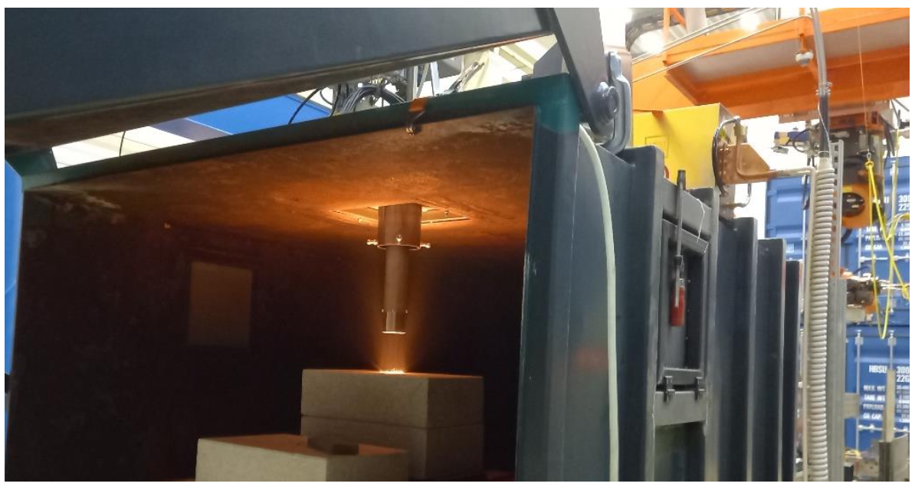
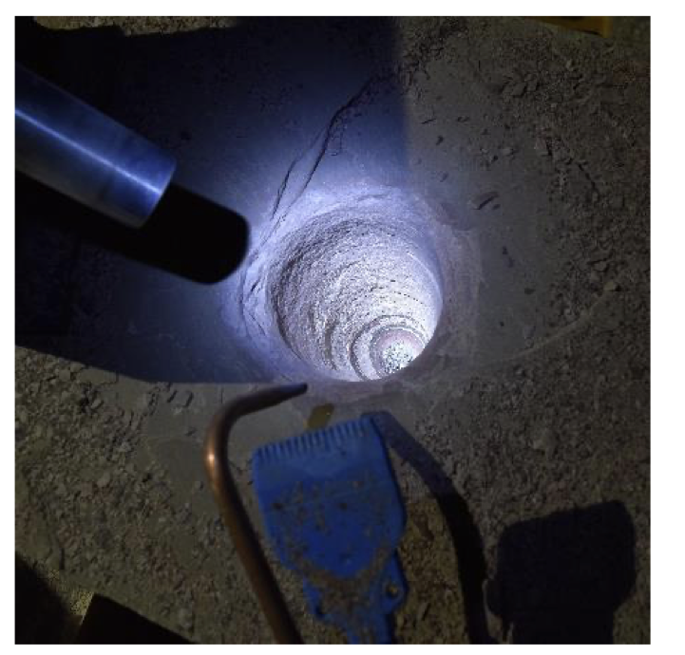
LABORATORY TESTS
A lab for experimental development and testing of the new laser drilling process
The technical equipment includes
a high-power laser system
processing optics
a drill string with the special 3D printed drill head
a gas feeding system, with which the process gas can be tempered
The drill string is mounted on a robot.
The process application takes place inside a press container, which acts as a safety enclosure
Constant ROPs upwards of 20m/hr have been achieved, with relatively low energy inputs and no component wear.

Slide 7
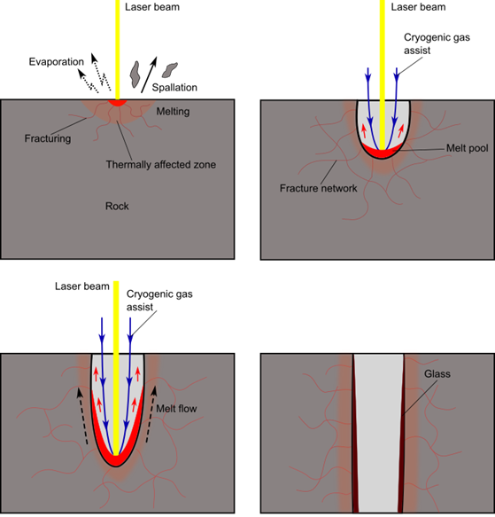
CHARACTERIZATION OF THE ROCK SAMPLES
The petro-thermo-mechanical phenomena affecting different rocks are being analysed, also to assess the borehole wall vitrification and integrity.

Slide 8
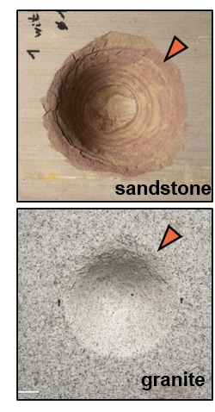
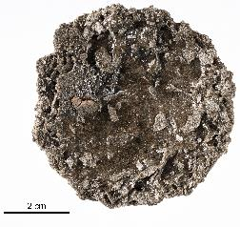
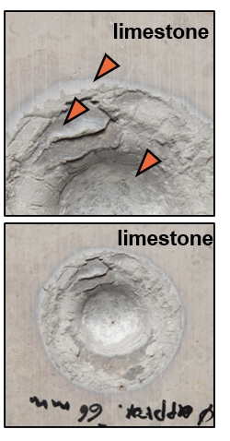
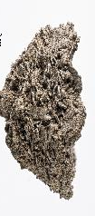
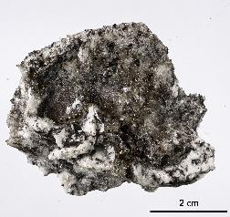
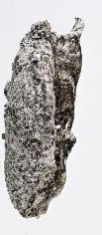
CHARACTERIZATION OF THE ROCK SAMPLES
The petro-thermo-mechanical phenomena affecting different rocks are being analysed, also to assess the borehole wall vitrification and integrity.
glass
glass

Slide 9
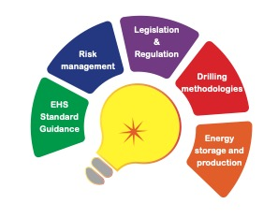
MARKET ANALYSIS FOR A SUSTAINABLE DEPLOYMENT
The project will analyse and assess:
              The exploitation potential
              The economics of the developed drilling technology
              The legislative aspects and environmental
              Health and safety (EHS) standards related to the proposed solution.
              The risks assessment comparing DeepU technology to conventional deep drilling

Slide 10
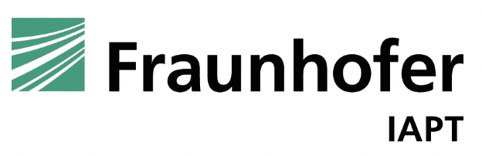
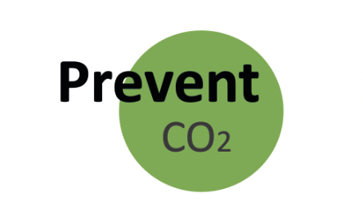



THE PROJECT TEAM
This research is funded by the European Union (G.A. 101046937). However, the views and opinions expressed are those of the author(s) only and do not necessarily reflect those of the European Union or EISMEA. Neither the European Union nor the granting authority can be held responsible for them.

