Slide 1
The UmbiliDrill methodology for drilling long reach and sharp turn wellbores for geothermal and underground infrastructure micro-tunnels
Henning Hansen – henning.hansen@aai.no - +47 9024 0910
Drilling with an umbilical: UmbiliDrill
High-impact innovations
Patents pending and granted

Slide 2
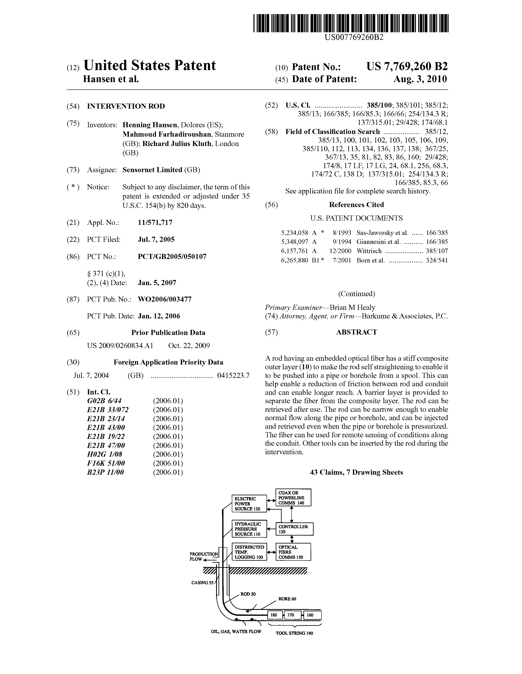
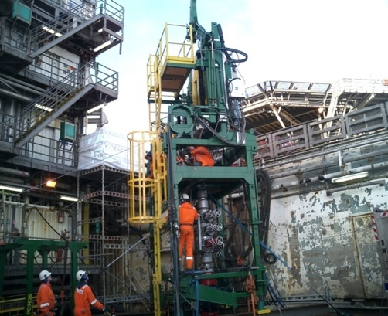
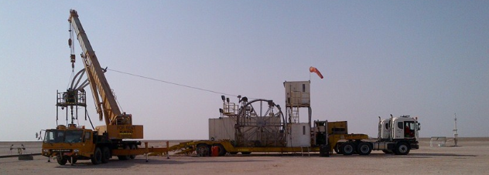
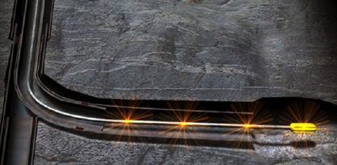
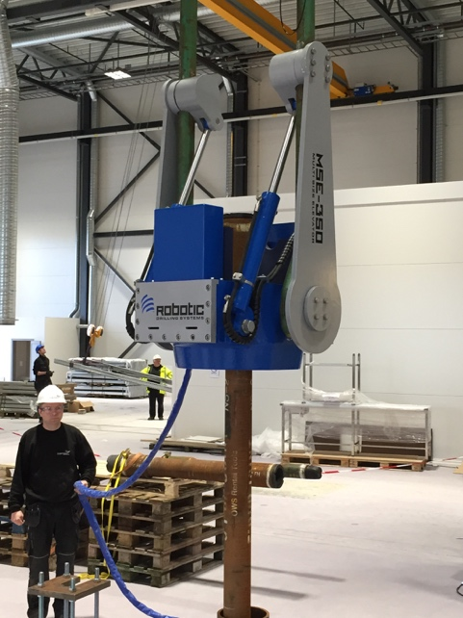

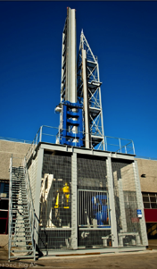
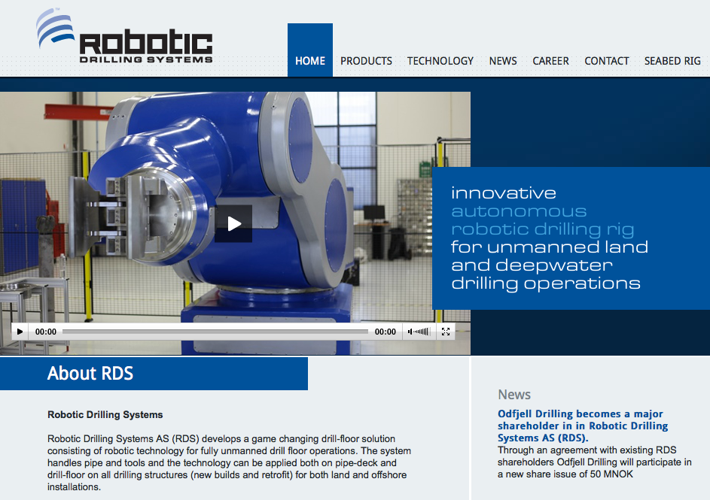
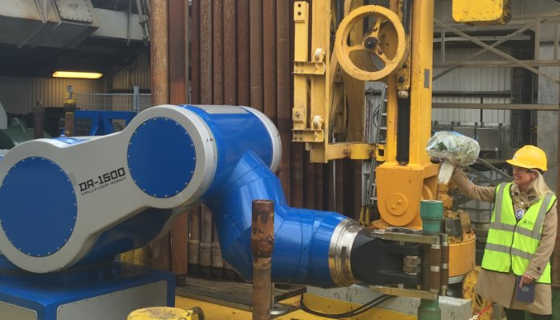
I have invented and commercialized a lot of related technologies
60+ patents within wellbore and subsea technologies and methods
Instrumental in establishing and building up 17 technology companies in Norway, UK, Abu Dhabi and USA
Aarbakke Innovation has close to 25 innovative and experienced design engineers; Mechanics, electronics, electrical systems, hydraulics, etc.

Slide 3
WHAT WE PROPOSE TO BE REVITALIZED AND DEVELOPED
The “UmbiliDrill” System
An electrical drilling machine system operated by a spool-able/joined umbilical deployed from the surface
Long reach – Join x number of umbilicals with “locomotive” drive systems between them
Sharp deviations enabling underground loops, and the drilling of fluid in and fluid out wellbore in same operation – Remove need for ”fracking”
Composite umbilical strong enough to pull drilling machine back out of the wellbore, including “tractoring” capabilities in drilling machine
High flow rate circulation (including downhole pumps) that will cool the entire underground drilling system, including the umbilical
  Relevant high temperature composites have emerged the recent couple of years makes it feasible to build an umbilical to handle temperatures up to 200ºC
  We are manufacturing wellbore heating systems delivering 500ºC downhole, and these are deployed by an umbilical – So a lot of in-house high temperature experience now

Slide 4
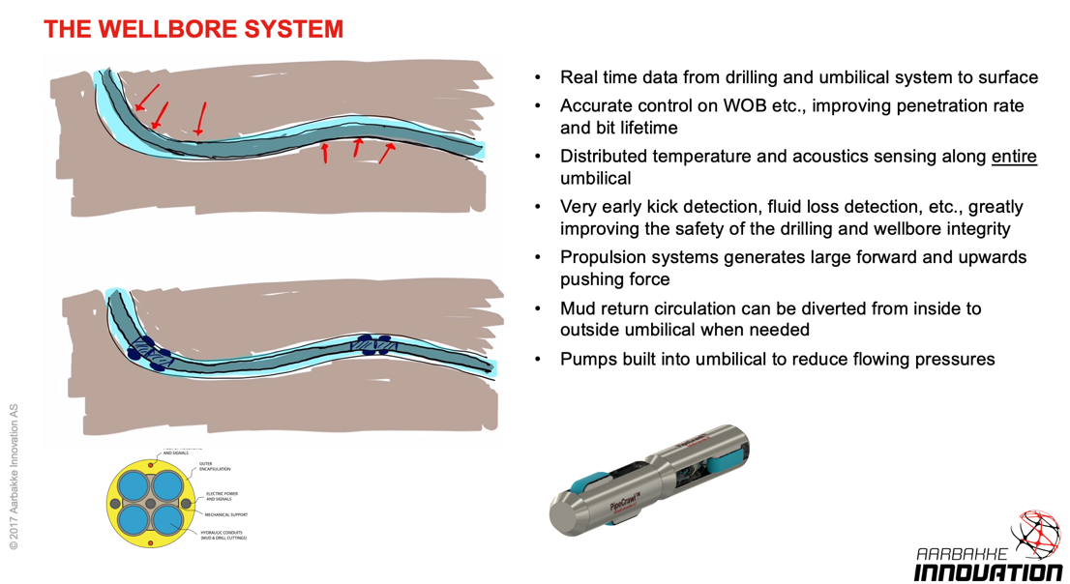
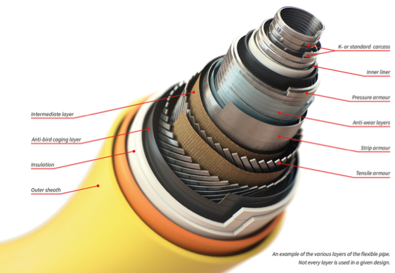

Slide 5
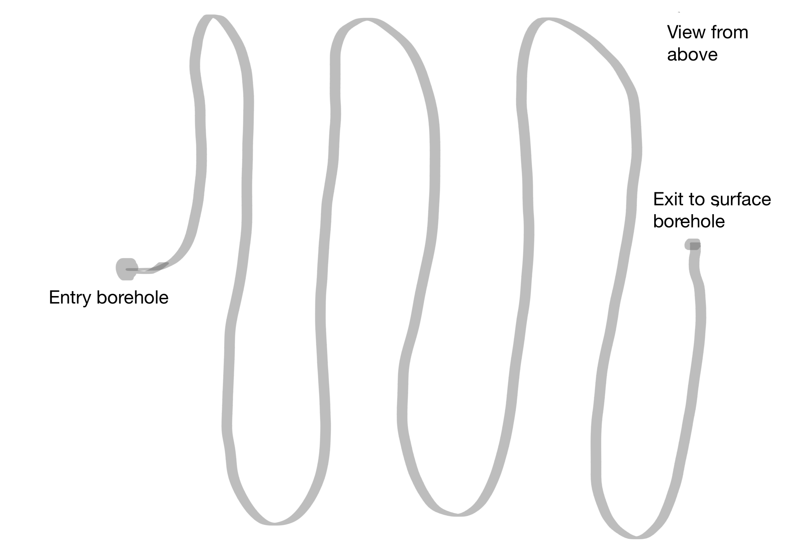
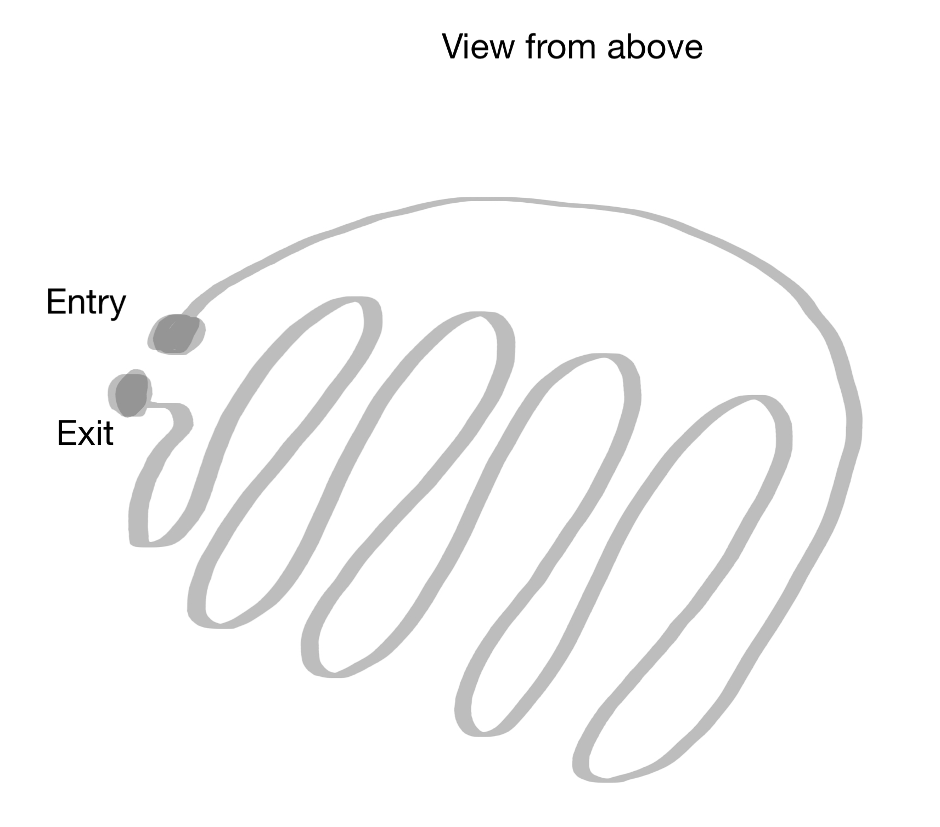
GEOTHERMAL DRILLING
Underground loops
  Superior thermal contact for circulated fluid
  Avoid fracking
  Greatly reduced energy required to circulate cold water to hot water outlet (Pumps do not need to pump fluid through tine cracks in the rock)
  Much smaller surface footprint required

Slide 6
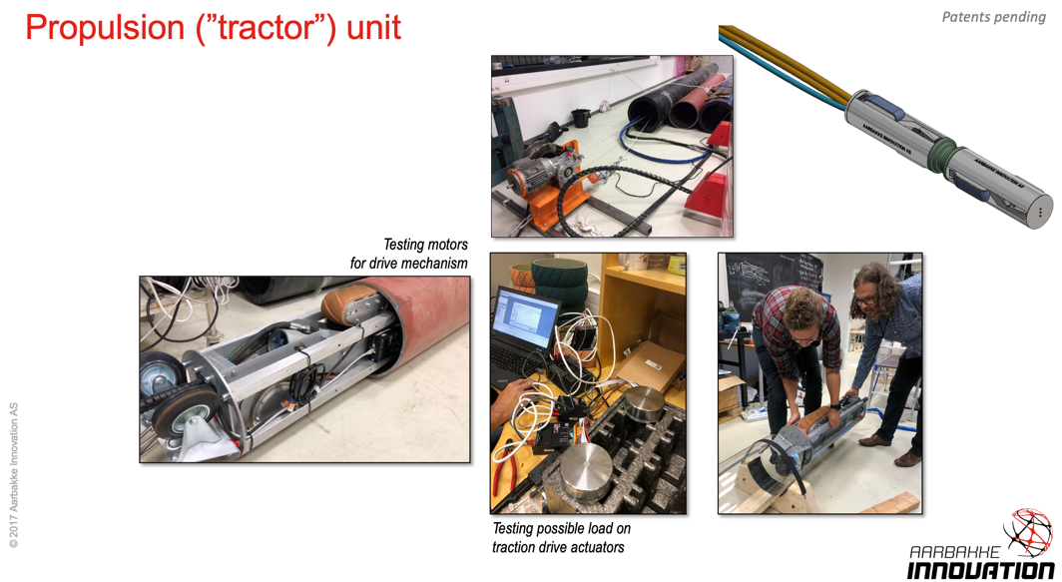

Slide 7
Drilling mode

Slide 8
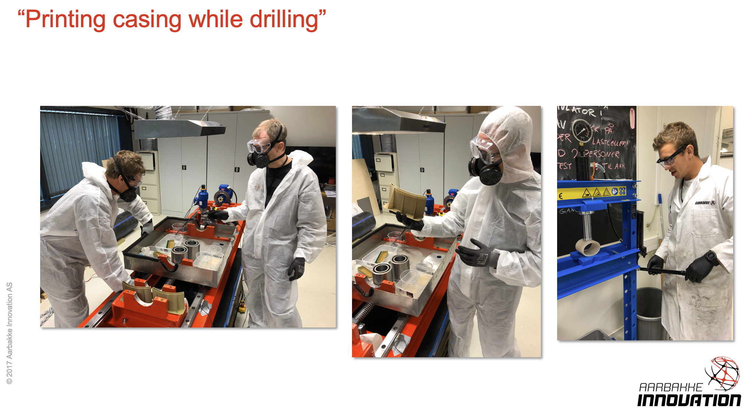
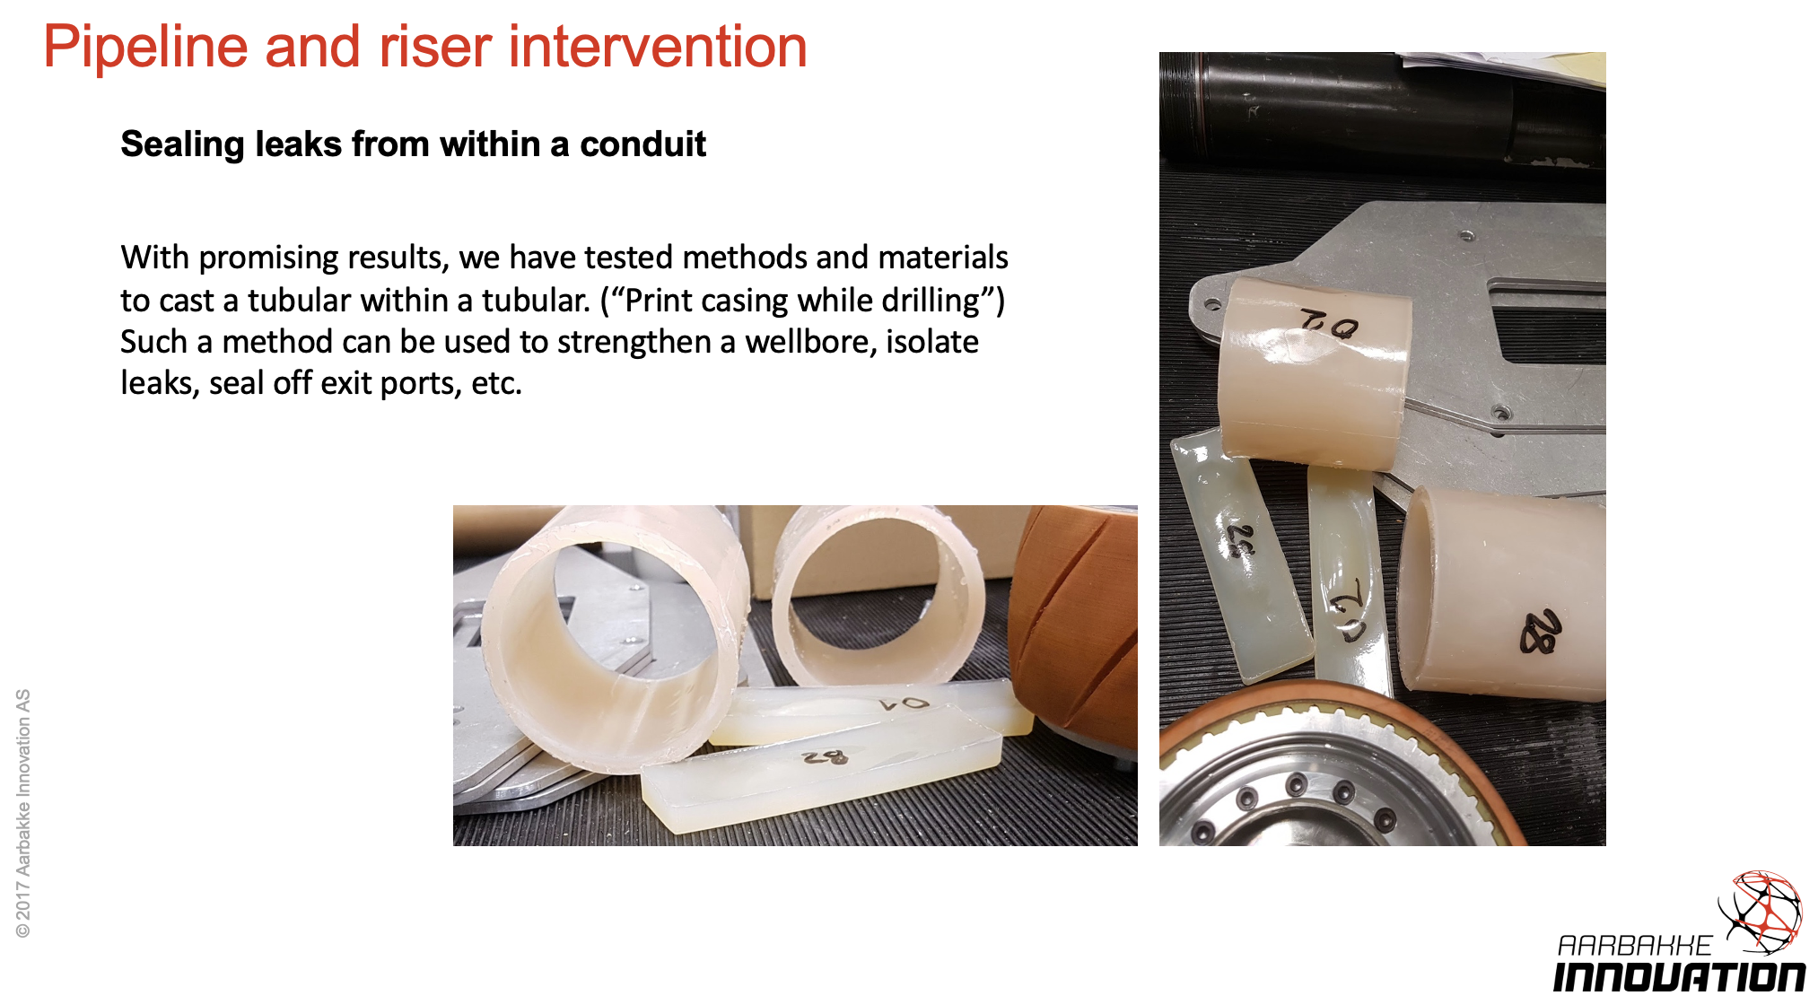

Slide 9


