Slide 1


SLB New Energy Geothermal
Sep 2023

Slide 2

Who we are
What we do
Why

Slide 3
Engines of growth
Digital
Intelligent platforms
for the energy industry
and beyond
Core O&G
Industry Leader in a
low cost / low carbon
environment
New Energy
Technology solutions
innovator for the
energy transition

Slide 4
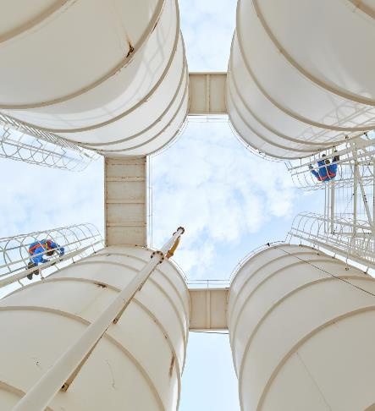
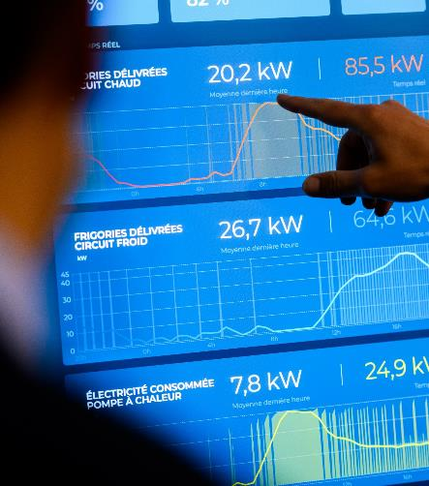

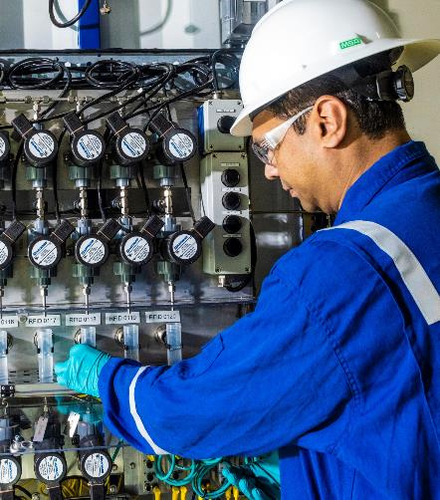
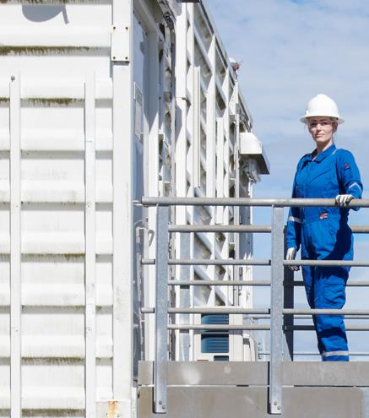
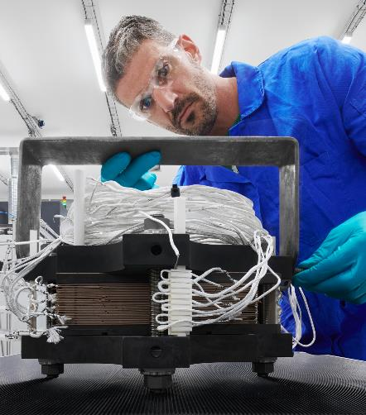
SLB’s
New Energy Business
Accelerating decarbonization through innovation and science—on a global scale
Focus Areas
Carbon
Solutions
Geothermal
and Geoenergy
Critical
Minerals
Stationary
Energy Storage
Hydrogen

Slide 5
Geothermal Project Cycle, Cost & Risk Profile
Detailed design & Construction
Reconnaissance
Exploration
Pre-Feasibility
Feasibility
Development
Drilling
Power Plant
Operations
Pre-Feasibility
Feasibility
Development
Drilling
Power Plant
Operations
Geophysical, geological and geochemical field work and analysis.
Site evaluation
Preliminary environmental review
Focused exploration
Temperature gradient drilling
Slim holes
First successful well
Confirmation and reserve estimation
Project feasibility study
Production and injection wells
Well logging and testing
Construction of power plant and steam gathering system
Surveillance
Maintenance
Makeup wells drilling
Expansion evaluation.
Year 1
Year 1-2
Year 2-3
Year 3-4
Year 4-5
Year 5+
Spend as % of Total Capex¹
89.9%
Cost
9.0%
Routine Operations
Opex driven
0.1%
1.0%
High
Risk
Low
¹. Hypothetical 20 MW project
5
Source: www.slb.com/Geothermal

Slide 6
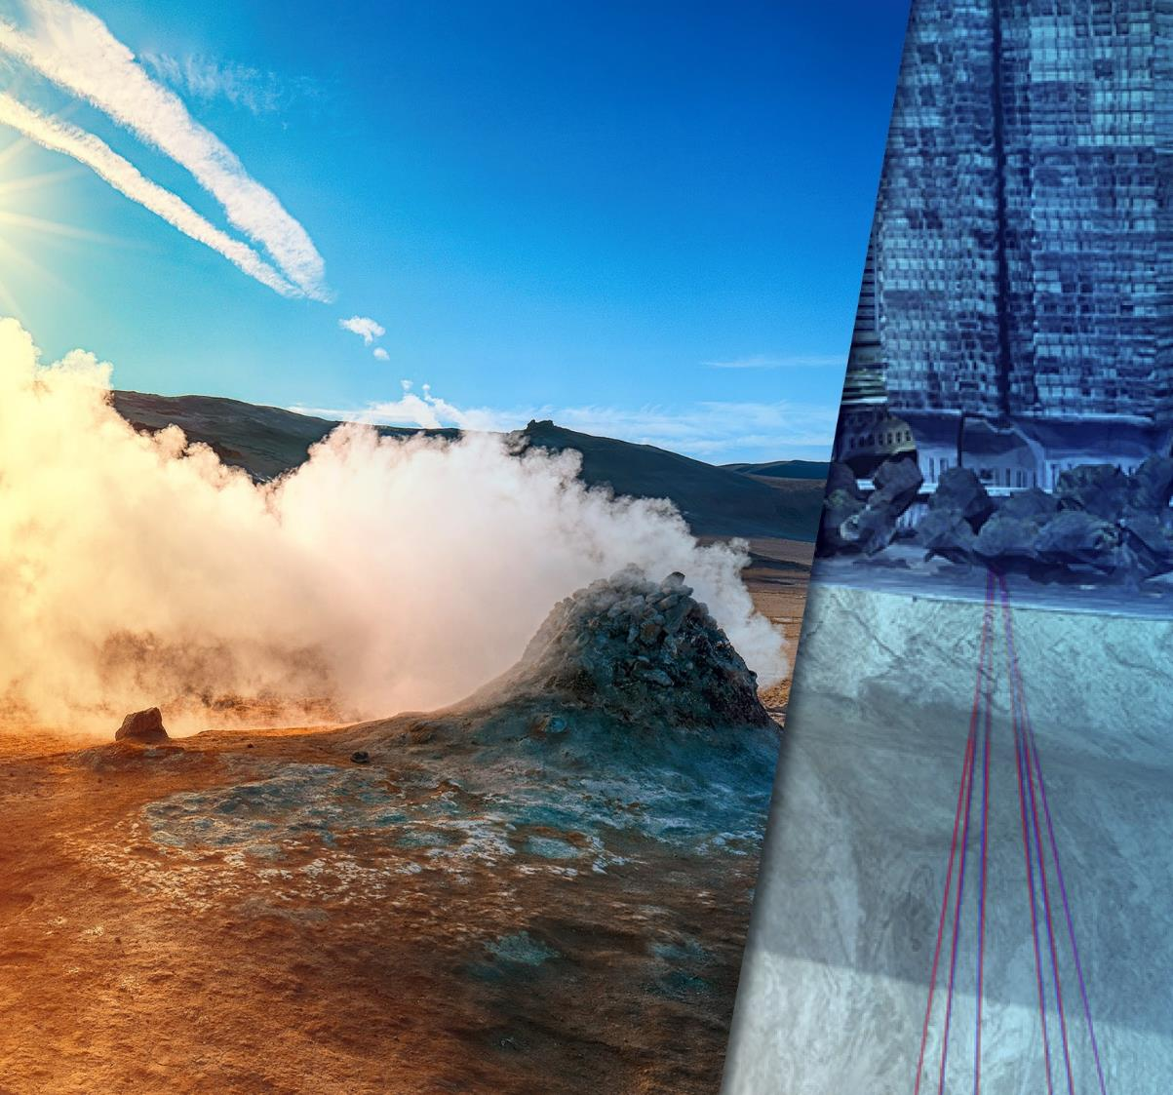
Our geothermal capabilities
Half a Century of Geothermal Leadership

Slide 7
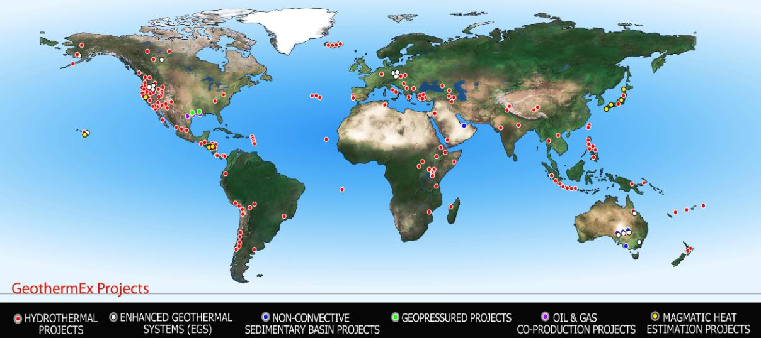
Geothermal Subsurface Evaluation
GeothermEx: gold standard for resource assessment in geothermal industry
Experience & Capabilities
  Exploration, development, modeling and optimization of geothermal resource
  Resource assessment: quantification of power, heat and minerals in solution
  Conventional, EGS and closed-loop (AGS) solutions
Expertise
  Geosciences
  Reservoir engineering
  Field development
  Project de-risking
  Well testing
  Production optimization
Achievements & Experience
  50 years in geothermal
  Support for project financing for 8.5 GW geothermal power
  Involved in $14B+ invested in geothermal projects

Slide 8
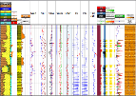
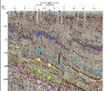
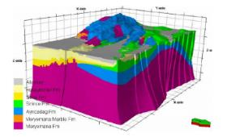
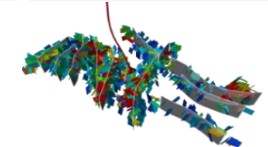
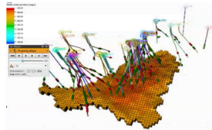
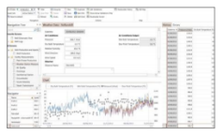













Geothermal Digital
Transform geothermal data into business decision that maximizes asset value
Exploration
Feasibility
Appraisal
Drilling &
Construction
Operations
Geophysical (Seismic, EM, Gravity), geological and geochemical analysis
Preliminary well tests, Core and Drilling data
Advanced processing
and interpretation
Conceptual static modelling
Model dynamic behavior
Fracture Prediction & Well Placement
Well placement/design
Completion optimization (Casing/tubing size, Optimum flow rates, Fracturing design)
  Drilling risks
  Well integrity
  Subsidence
  Induced seismicity
ML/AI

Slide 9


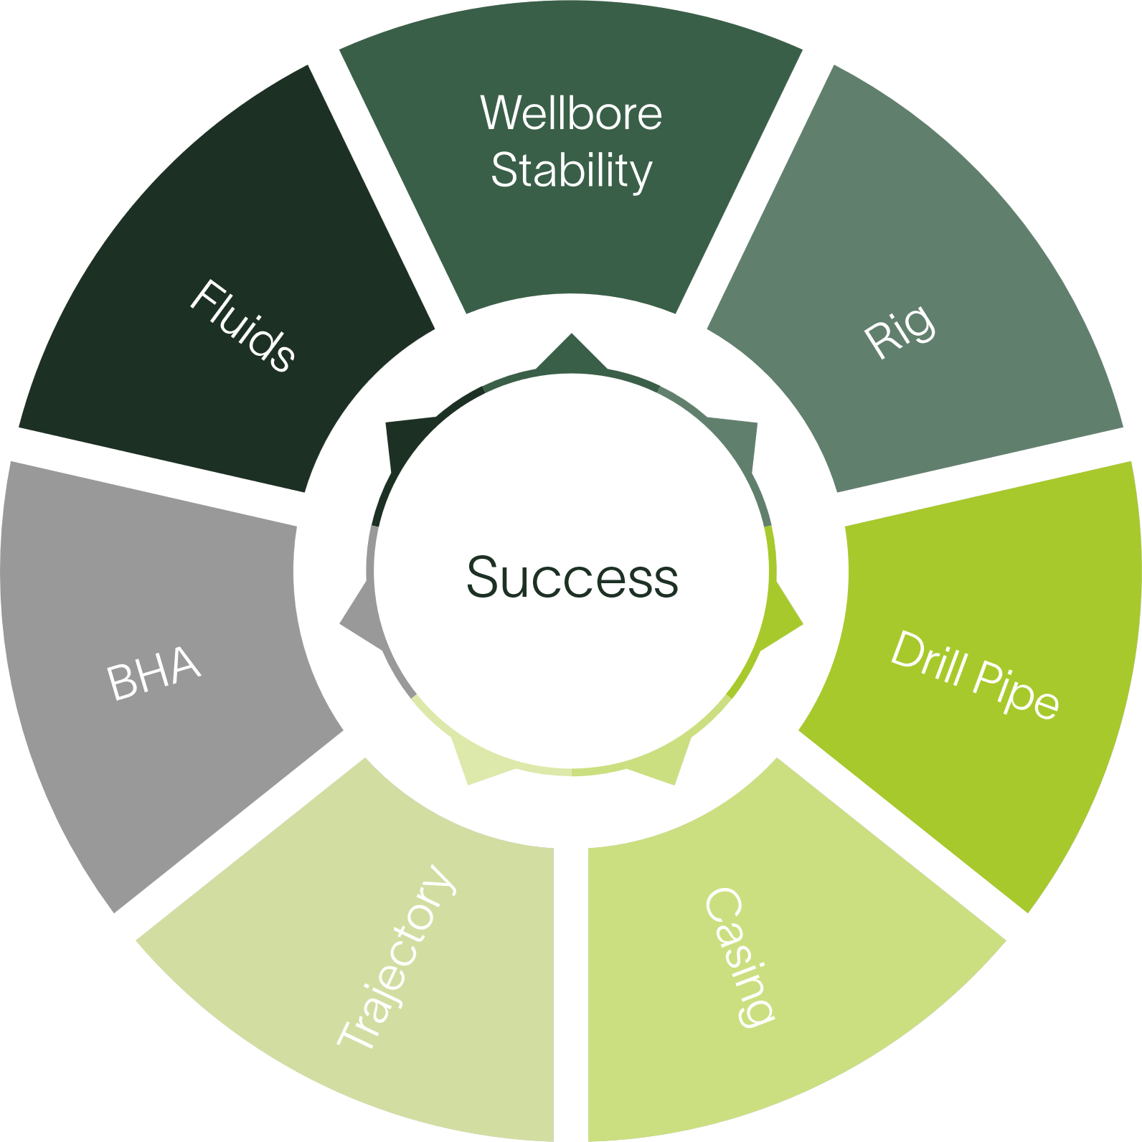


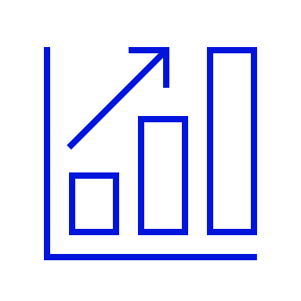

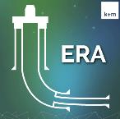
Geothermal Well Engineering
From well concept to detailed engineering and optimized execution
Optimize execution
  MSE analysis for drilling performance and disfunction identification
  Integrated torque & drag, hydraulics, and geomechanics planning and execution
World leading engineers
  Feasibility studies
  Conceptual well design
  Temperature modelling
  Offset well analysis
Engineering
Operational Support
K&M
Training
Wellbore Placement
Reduce EOU while drilling
Ranging expertise during planning and execution
World leading training courses
  Well design training for engineers
  Operational training for rig personnel
  Each course customized to meet customer needs
Software
Industry leading well engineering and execution software
Integrated torque, drag, hydraulics, and geomechanics
Accounts for HT effects on fluids
MSE analysis

Slide 10



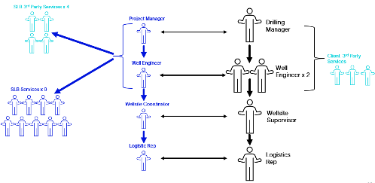

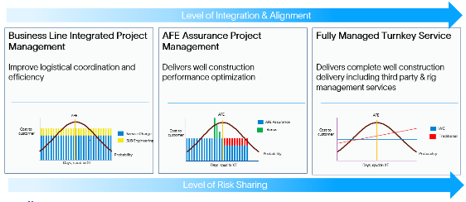


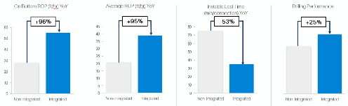
Geothermal Project Execution
Integration is key for successful execution
Manage rig performance
  Equipment
  Continuous improvement
  Digital and automation
Manage 3rd parties
  Service quality
  Cost optimization
Technical experts
  Well engineers
  Wellsite leaders
  Project managers
Customer interface
People
3rd Parties
Integrated Project Management
Process & Risk Management
Commercial Models
Customer alignment
A model for each project
Project planning
Well engineering review
Digital well planning
Project execution
Performance
Improving rig and drilling performance

Slide 11
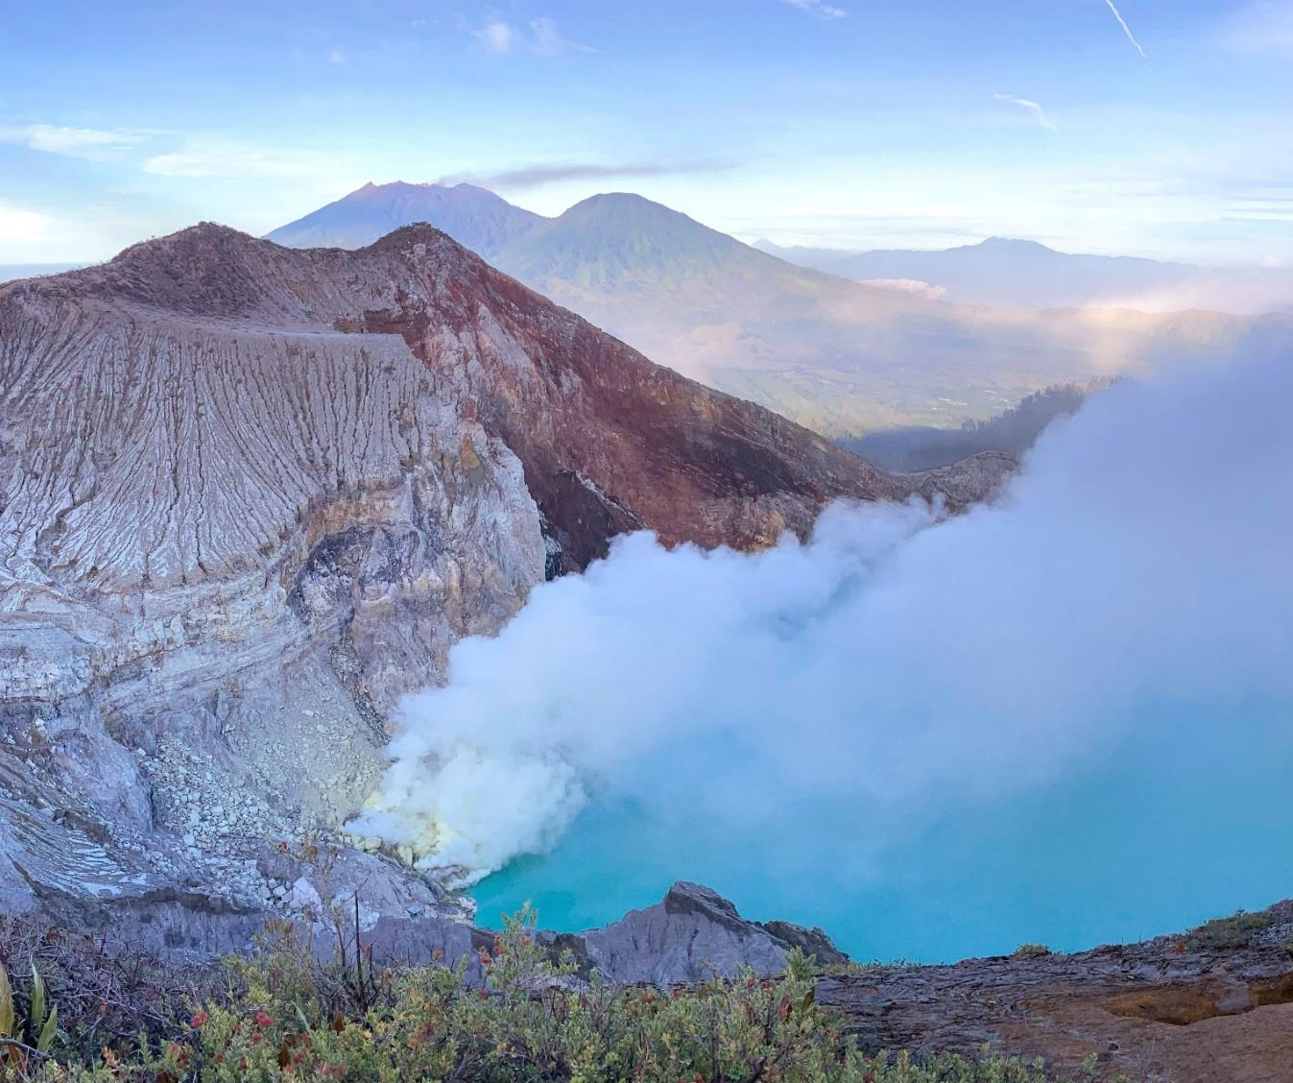
Our technology portfolio for geothermal
Leveraging our O&G technologies and expertise

Slide 12
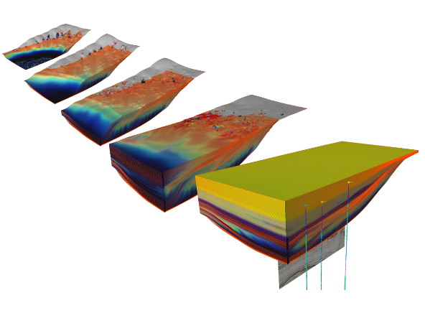
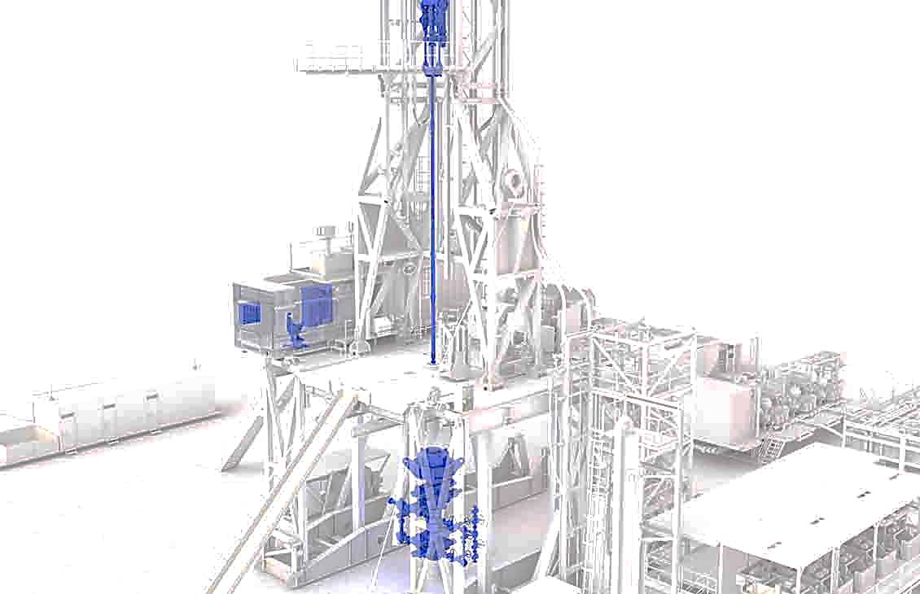
Addressing geothermal specific challenges
Cost-effective planning and project de-risking
    Geoscientific exploration for subsurface characterization
    Static modelling & reservoir engineering
    Well data acquisition & interpretation
    Production forecasting & sustainability
Best-in-class drilling & production performance to lower cost per MW
    Better ROP and longer bit runs in hot and hard rock
    Large diameter drilling: steering, logging
    Fit-for-purpose drilling fluids and cementing solutions
    Maximize production with optimized net energy output

Slide 13
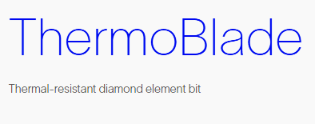
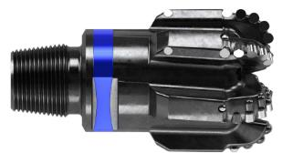
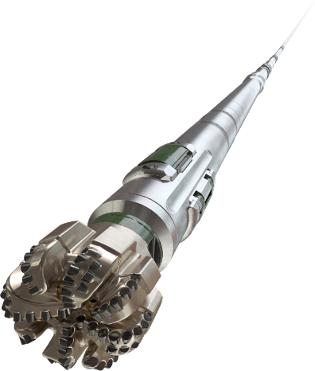
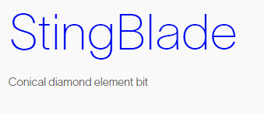
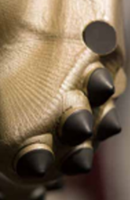

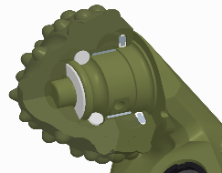
Drill Bits
120+ years of global expertise from O&G to Geothermal
    Thick Diamond Table Cutters and Shaped Diamond Elements expand usability of Fixed Cutter bits in geothermal environment
    ThermoBlade™ thermal-resistant diamond cutting elements
      Extends cutter life by reducing damage due to thermal degradation
      Improves bit performance by maintaining a sharp cutting edge to sustain high levels of ROP
    StingBlade™ conical diamond element bit
      Stinger conical diamond element point-loads the formation
Roller Cone bits continue to evolve and perform in deep geothermal applications
    Kaldera™ seals and grease to extend bearing life in HT environments
    Optimized cutting structures for hard rock drilling

Slide 14
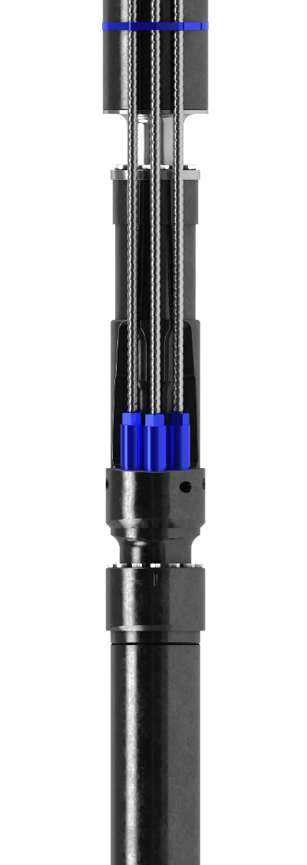
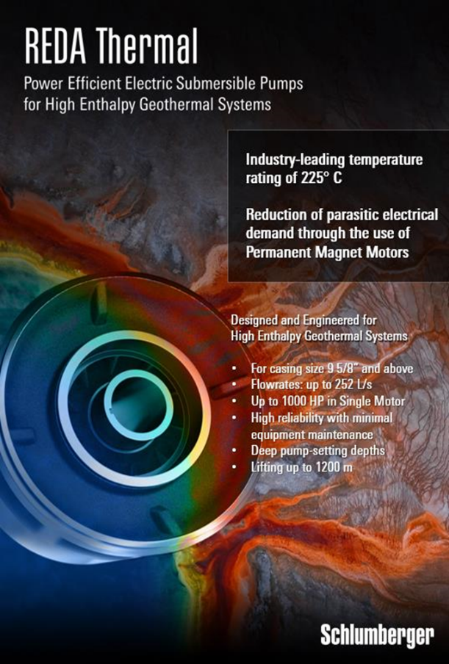

Reda Thermal™
ESP
    Optimize medium- to high-enthalpy geothermal wells
    Increase economic output and capex efficiency
    Revive nonflowing wells, boost production, and delay the need for new drills
    Lower parasitic load and enable fast installation with great flexibility
    Proven success with over 55% production improvement and world record reliability

Slide 15
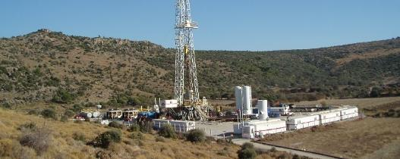
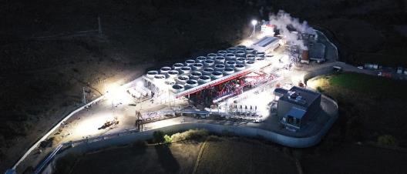
Case Study: Turkey Power
From Exploration to Power Generation
Application
    Geothermal system: hydrothermal
    Power generation
    Reservoir temperature: <150 C
Challenges
    Exploration risk
    Develop geothermal project for power generation within time and budget
    Project financing
Solution
    Feasibility study
      3G* studies, exploration data evaluation, well targeting
    Resource modeling
    Well design, drilling and testing program
    Drilling execution
      Project management, wellhead, cementing, mud services, mud logging, bits, jars, coiled tubing services
Results
    Support for project financing
    Drilled 7 wells: 4 production and 3 injectors
    Well production rates of 270–420 metric tons/hr/well
Business Impact
    Project with 12 MW power generation

Slide 16
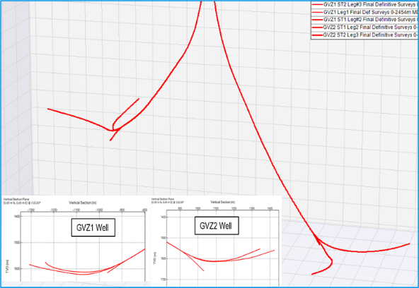
Case Study: France Heating
First of its kind multi-lateral well design for geothermal heating application
Application
    Geothermal System: District Heating
    Reservoir Temperature: <150 C
    Well Type: Horizontal
Challenges
    Conventional single bore well design unable to meet targeted flow rates
    First ever multi-drain geothermal wells in France
    8-1/2” drilling in Carbonate Limestone reservoir (Dogger) with 18 Kpsi
    First time Archer RSS deployment
Solution
    AxeBlade PDC Bit XS616, PowerDrive Archer, MWD Telescope
    i-DRILL modeling for steerability and stability
Results
    Drilled 2 wells with 3 laterals each
      6 x boreholes
      4 x OH sidetracks
      1 x drilling BHA
    100% operating efficiency & sidetrack success rate
    Achieved 6-7°/30m DLS with 70% steering ratio – matching the IDEAS model
Awarded the Ruggero Bertani Innovation Award at EGEC 2021
Business Impact
    Multi-drain 3D well profile increase well productivity by 80%
    16 MW heating generation for 12,000 homes

Slide 17
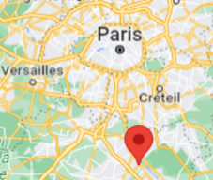

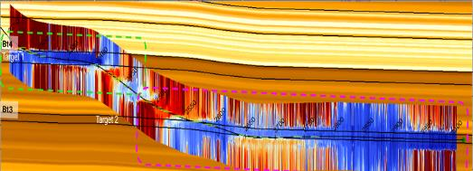
Case Study: France
Geosteering for Geothermal Heating
Application
    Geothermal System: District Heating
    Reservoir Temperature: 70° C
    Well Type: Horizontal / Doublet
Challenges
    Urgent need for heat source to supply the city district heating network
    Insufficient flow production from conventional drilling techniques
    Carbonates Limestone reservoir (Dogger), 18 Kpsi UCS, 9.5” section
Multi-boundary mapping while drilling, with PeriScopeHD, to remain in the most productive layers of the reservoir
Solution
    Well Placement with PeriScopeHD and EcoScope to navigate the reservoir
    Horizontal drilling RSS BHA for accurate steering control
    Hole opening while drilling
Results
    First geothermal application of PeriScopeHD
    Reservoir properties evaluation with EcoScope to qualify sweet spot
    Elimination of Pilot Hole in the 2nd well thanks to LWD accuracy
    Hole opening to 9.5” while drilling enhanced flow production
Customer
SMP Energies / GPC IP
Business Impact
    100% production increase compared to conventional geothermal well
    15 MW of heating capacity
    Avoid 15,000 metric Tons of CO2 emissions per year

Slide 18
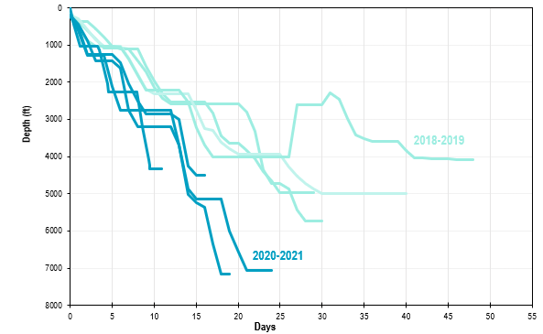
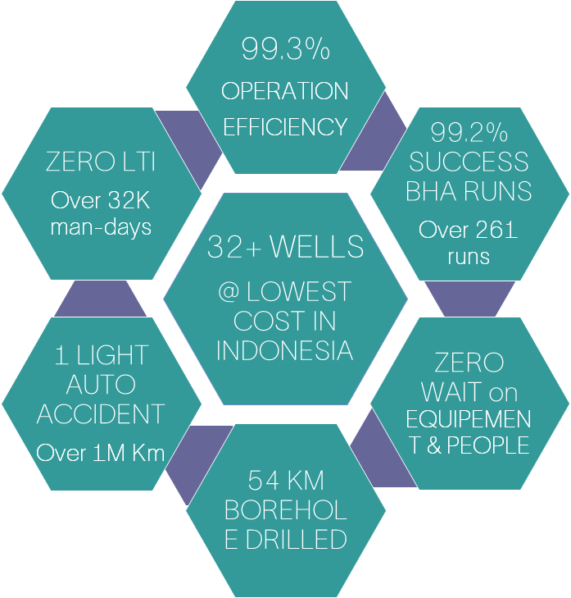
Case Study:
Indonesia
Drilling Performance via Integration
Application
    Geothermal system: hydrothermal
    Power generation
    Reservoir temperature: >200 C
Challenges
    Drilling performance within time and budget
    Exploration risk
    Drilling risks: well control, total losses, stuck pipe, etc
Solution
    Project Execution via Integrated Well Construction
      Well design
      Drilling and testing program
      Project management
      Drilling services
      3rd parties management including rig & tangibles
      In-house subsurface support (GeothermEx)
Results

Slide 19
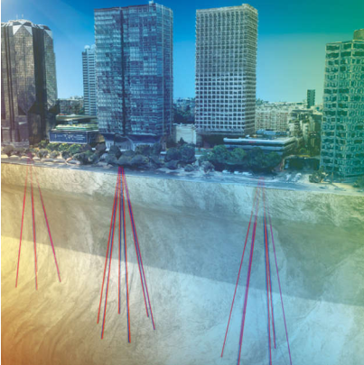
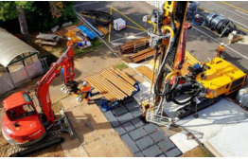
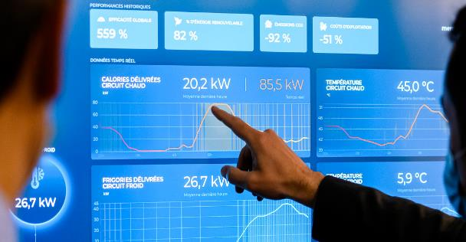
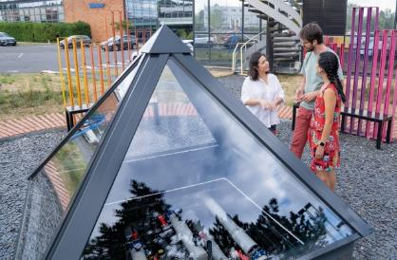
Geoenergy for Heating and Cooling – Celsius Energy
Celsius Energy connects buildings to the Earth’s continuous and resilient energy resources,
delivering heating and cooling while reducing CO₂ emissions by as much as 90% and operating costs up to 50%.
The Celsius Energy system
Turnkey solution for collective buildings
Pilot project operating since 2020 in Clamart, France
150 wells and 7 exchangers completed worldwide
Very small footprint thanks to inclined borehole design
Native digital solution: fit-for-purpose software models,
smart energy management system

Slide 20


SLB is a global geothermal technology leader
Proven Expertise in Geothermal
    With GeothermEx consulting services we have 50 years of expertise
    Involved in over 70% of existing geothermal projects 11GW power generation
Focus in improving geothermal project economics → reduce $/MW
    Resource assessment to minimize risks associated with exploration and development phases
    Model geothermal asset and design effective field development to target sustained long-term asset performance
Project execution with drilling efficiency
    Proven track record managing integrated projects with 12,000+ wells drilled
    Best drilling performance applying fit-for-purpose technologies while achieving well placement, formation evaluation and completion objectives
Production optimization while monitoring resource
    Long term sustainable asset production with best-in-class ESP technology maximizing net energy output
    Effective technologies to monitor resource and mitigate corrosion
Electricity
Heating

Slide 21
Thank you
Links to papers and webinars:
Webinars: slb.com/geothermal-webinars
Technical Papers: GRC-2023
A Fracture Characterization Case Study from Utah FORGE
Directional & Surveying Challenges in Geothermal Well Construction
Numerical Simulation of Rock Cutting for Utah FORGE
An inverse model for estimating unknown fracture aperture distributions
Technical Presentations: GeoTHERM 2024
A world’s first geosteering application in Geothermal
Novel Electrical Submergible Pump (ESP) technology boosted production by 56% from High-Enthalpy Geothermal Wells
Real-Time Data Simulator for the Qualification of DAS Passive Seismic Geothermal Monitoring Systems
slb.com/geothermal

